Slide 1
Lecture 3: Images and convolutional neural networks
Practical deep learning

Slide 2
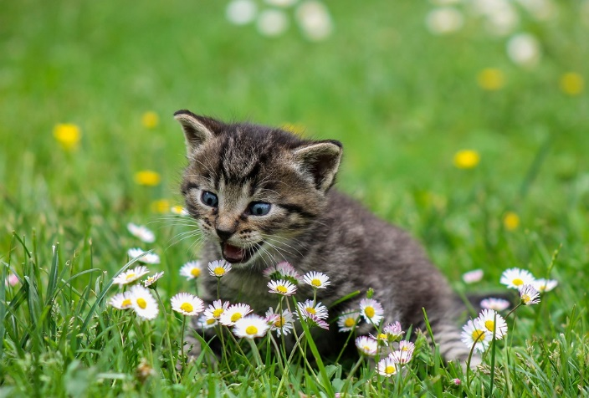
From picture to pixels
An image has to be digitized for computer processing
It is turned into millions of “pixel” elements
0.49411765 | 0.49411765 | 0.4745098 | 0.49019608 | 0.4745098
0.49411765 | 0.49411765 | 0.5058824 | 0.49411765 | 0.49803922
0.49803922 | 0.49411765 | 0.4862745 | 0.47058824 | 0.49411765
0.5019608 | 0.49803922 | 0.49803922 | 0.49019608 | 0.50980395
0.50980395 | 0.5058824 | 0.52156866 | 0.50980395 | 0.5058824
Picture source: https://pixabay.com/en/kitty-cat-kid-cat-domestic-cat-2948404/
Each a set of numbers quantifying the color of that element

Slide 3
Convolutional neural network (CNN, ConvNet)
Dense or fully-connected: each neuron connected to all neurons in previous layer
CNN: only connected to a small “local” set of neurons
Radically reduces number of network connections
Dense layer
Convolutional layer

Slide 4

Convolution for image data
3✕3 weights (conv. kernel)
3✕3 image area
output
neuron
Image represented as 2D grid of values
Each output neuron connected to small 2D area in the image
Output value = weighted sum of inputs
Idea: nearby pixels are related ⇒ we can learn local relationships of pixels
Image source: https://mlnotebook.github.io/post/CNN1/

Slide 5
Convolution for image data
image input
3✕3 weights (conv. kernel)
We repeat for each output neuron
Weights stay the same (shared weights)
Border effect: without padding output area is smaller
Stride: amount of shift for the convolution kernel
Outputs form a “feature map”
feature map
Image source: https://mlnotebook.github.io/post/CNN1/

Slide 6
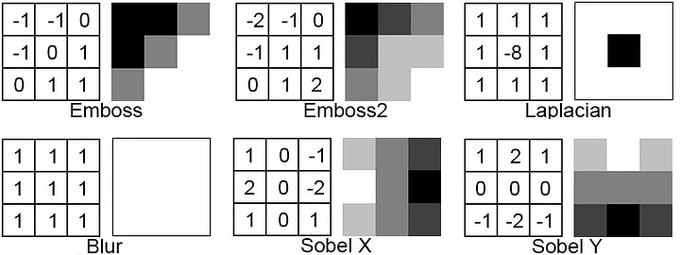
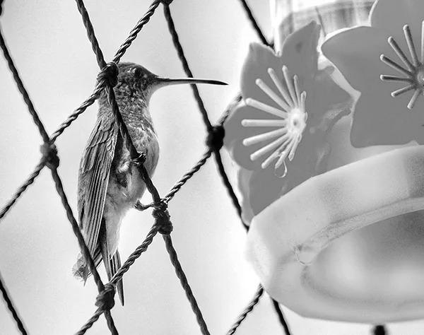
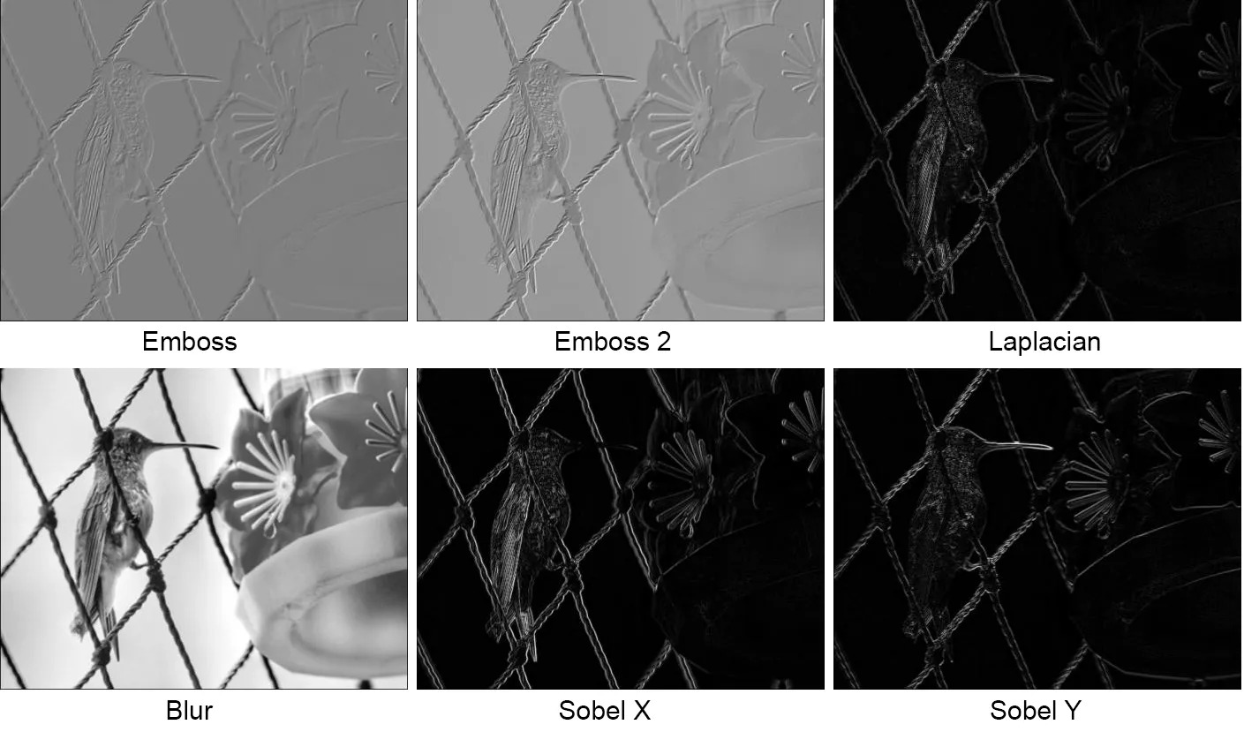
Convolution examples
Image from: https://medium.com/@er_95882/convolution-image-filters-cnns-and-examples-in-python-pytorch-bd3f3ac5df9c

Slide 7

A real example
Image from: http://cs.nyu.edu/~fergus/tutorials/deep_learning_cvpr12/fergus_dl_tutorial_final.pptx

Slide 8
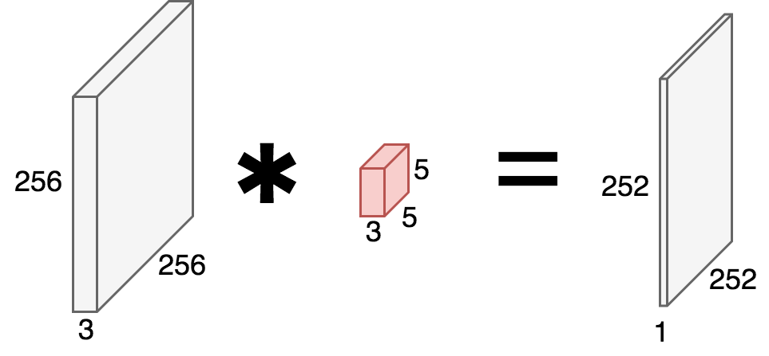
Side note: color images
Example: 256 ✕ 256 color image with 3 color channels (red, green, and blue) ⇒ single image is a 3D tensor: 256 ✕ 256 ✕ 3
Example: 5 ✕ 5 convolution is actually also a 3D tensor: 5 ✕ 5 ✕ 3
Slides over width and height, but covers the full color depth
Here: no padding, stride = 1

Slide 9
Convolution in neural nets
K feature maps each 252✕252✕1
We can repeat for different sets of weights (kernels)
Each learns a different “feature”
Typically: edges, corners, etc
Each outputs a feature map
K kernels each 5✕5(✕3)
image 256✕256(✕3)
...
...

Slide 10
Convolution in neural nets
output tensor 252✕252✕K
We stack the feature maps into a single tensor
Depth out output tensor = number of kernels K
Tensor is the output of the entire convolutional layer
K kernels each 5✕5(✕3)
image 256✕256(✕3)
...

Slide 11
Convolution in layers: intuition
We can then add another convolutional layer
This operates on the previous layer’s output tensor (feature maps)
Features layered from simple to more complex
“cat”

Slide 12

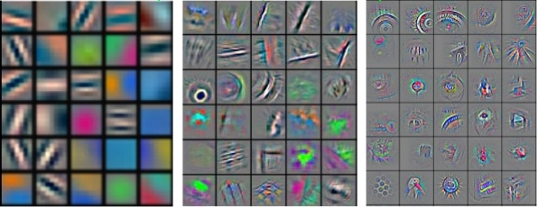
learned low-level features
learned mid-level features
learned high-level features
learned classifier
cat
Image from lecture by Yann Le Cun, original from Zeiler & Fergus (2013)

Slide 13
CNN applications

Slide 14

Typical architecture for classification
Input layer = image pixels
Convolution
ReLU
(Maybe) pooling
One or more fully connected layers (+ReLU)
Final fully connected layer to get to the number of classes
Softmax to get probability distribution over classes
Repeat one or more times

Slide 15

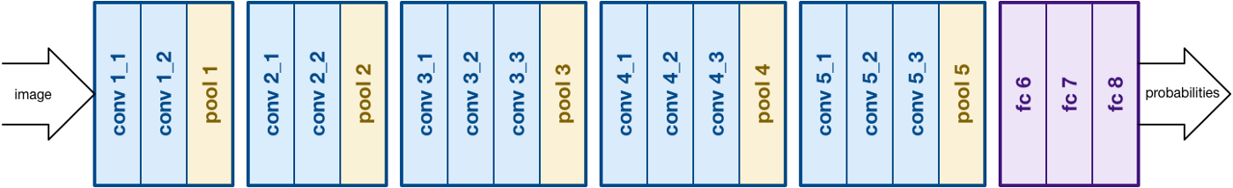

AlexNet
VGG
Inception

Slide 16
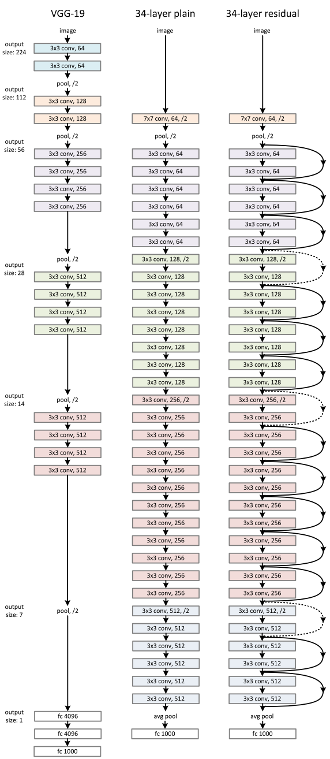
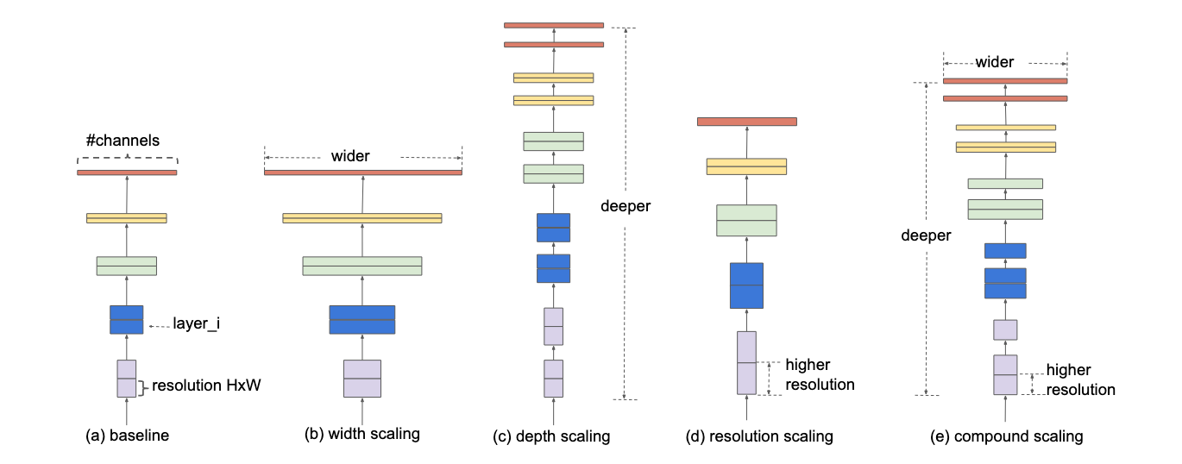
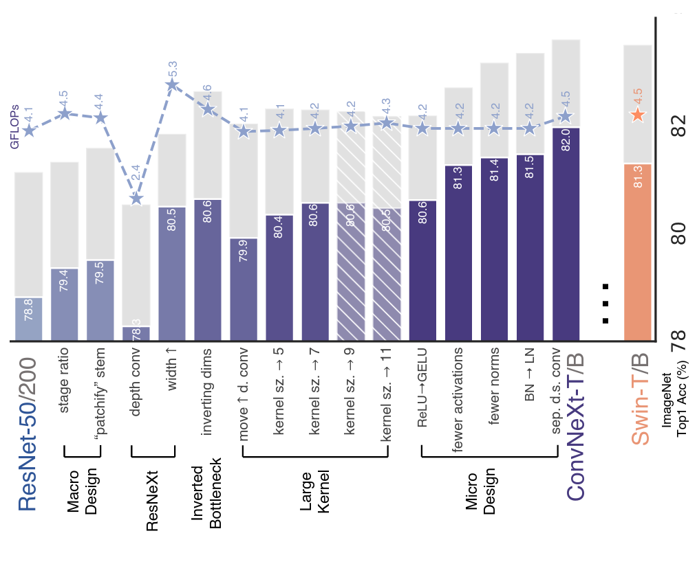
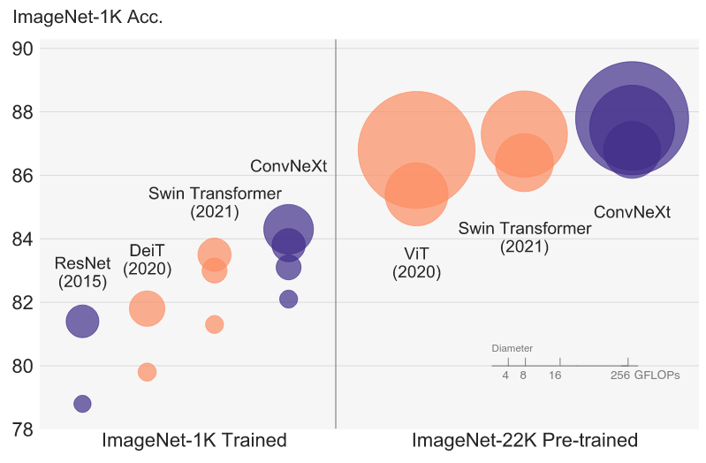
ResNet
EfficientNet
ConvNeXt

Slide 17
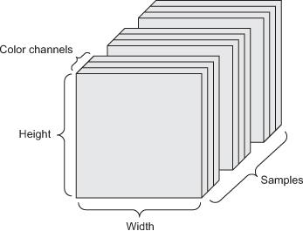
Large image datasets
Color image mini-batches are 4D tensors:
width ✕ height ✕ color channels ✕ samples
Plenty of big datasets for training exist, e.g.,
ImageNet, 1,2M images in 1000 classes
ImageNet-21K, 14M images in 14k classes
MIT Places, 2.5M images of 205 scenes
Open Images Dataset, 1,9M images with 600 objects with locations

Slide 18
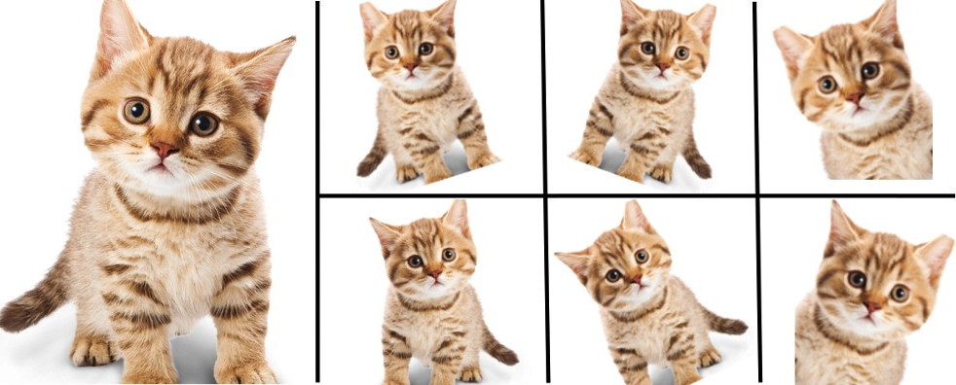
Data augmentation
Data augmentation = generate more training data by transforming existing data
This is easy for images, e.g.,
shifting
rotation
cropping
scaling
adding noise
etc …

Slide 19
Reusing CNNs with pre-trained weights
replace or retrain
extracted features
For many applications, an existing CNN can be re-used instead of training a new model from scratch: extract features from suitable layer or retrain the top layers with new data
Some models designed explicitly for re-use (transfer learning), e.g., BigTransfer
torchvision.models has several pre-trained models available
VGG, ResNet, Inception, MobileNet, DenseNet, EfficientNet, ConvNeXt, …
https://pytorch.org/vision/stable/models.html

Slide 20
Example: reusing pretrained VGG16
remove
add new layers (randomly initialized)
train them
fc1
fc2
train
fine tune also next block
fc1
fc2
retrain

Slide 21
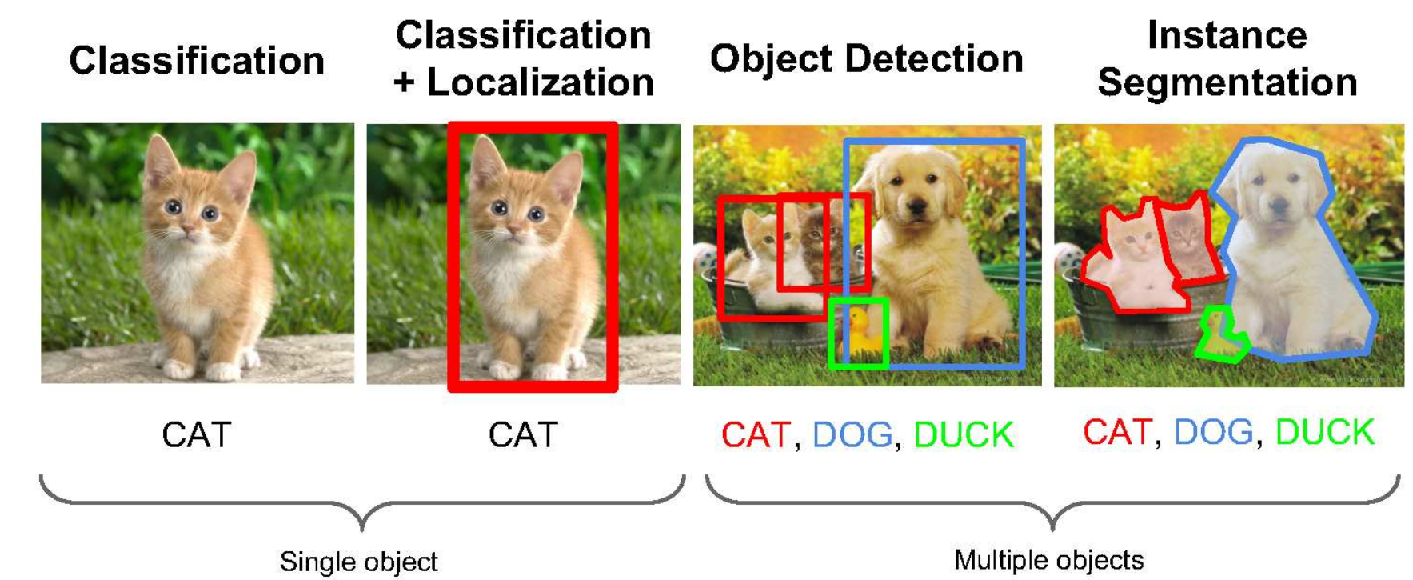
Computer vision applications
Image credit: Li Fei-Fei et al

Slide 22
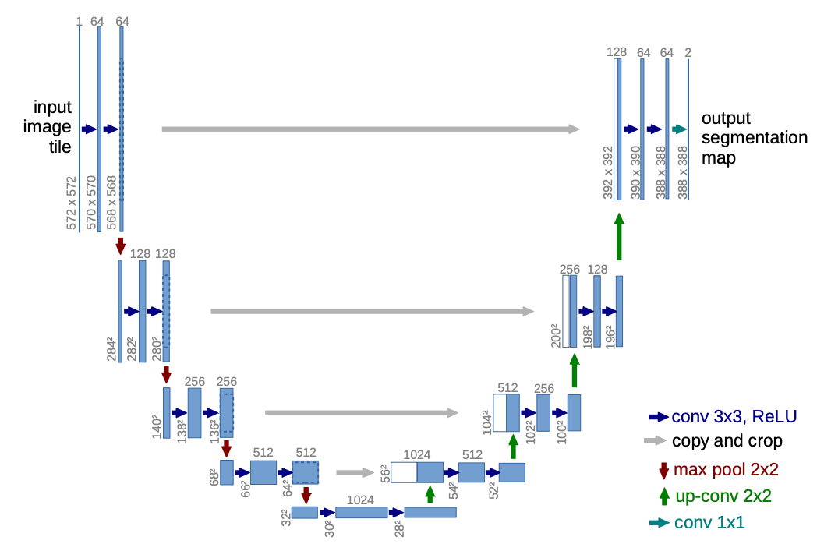
Example: CNNs used for segmentation (U-Net)
Image credit: Ronneberger et al, U-Net: Convolutional Networks for Biomedical Image Segmentation, 2015

Slide 23
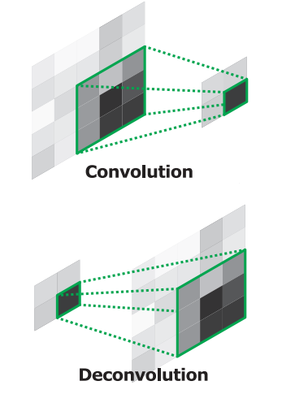
Transposed convolutional layer sometimes called “deconvolution”
Image source: Noh et al. “Learning Deconvolution Network for Semantic Segmentation”, ICCV 2015
Input: tensor of size N × W_{i} × H_{i} × C_{i}
Hyperparameters:
K: number of filters
w, h: kernel size
strides: amount of shift (horizontal and vertical)
padding: how to handle image borders
activation function
Output: tensor of size N × W_{o} × H_{o} × K
In tf.keras: layers.Conv2DTranspose(filters, kernel_size, strides, padding, activation)
Notes:
Basically does some padding to the input and performs convolution

Slide 24
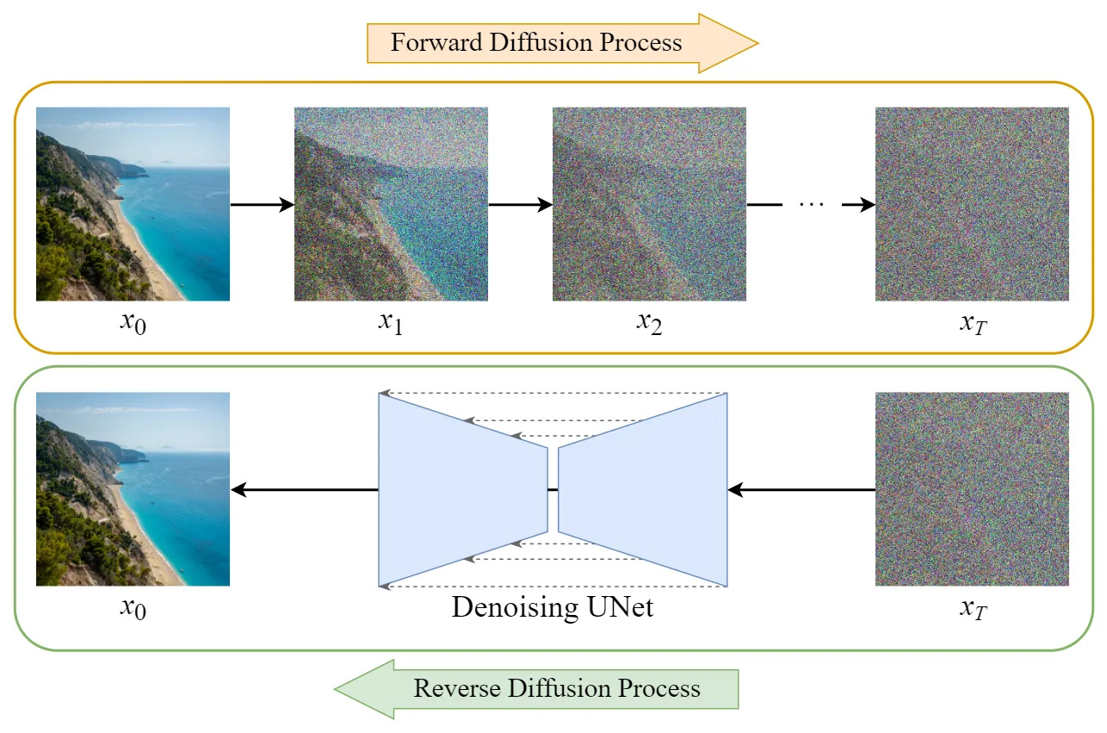
Diffusion models
Image credit: https://medium.com/@steinsfu/diffusion-model-clearly-explained-cd331bd41166

Slide 25
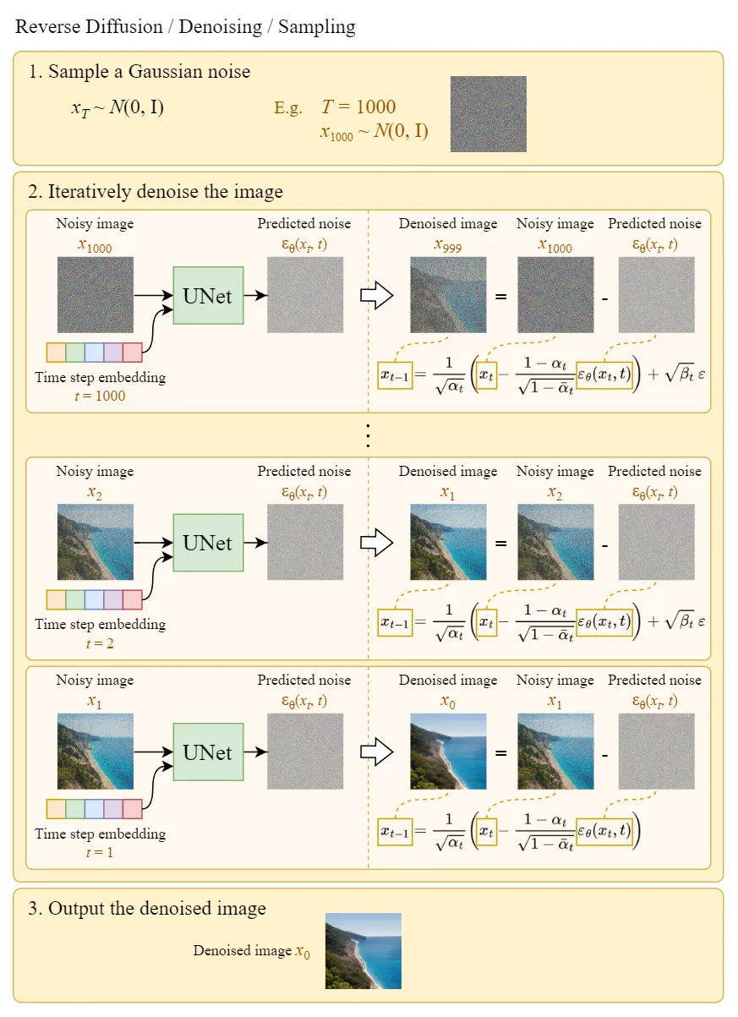
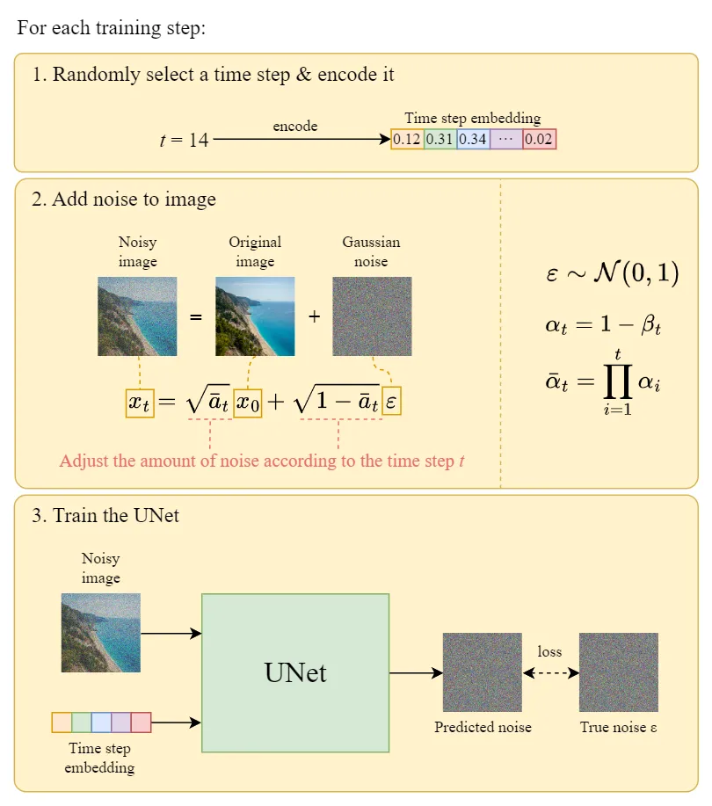
Diffusion models
Image credit: https://medium.com/@steinsfu/diffusion-model-clearly-explained-cd331bd41166

Slide 26
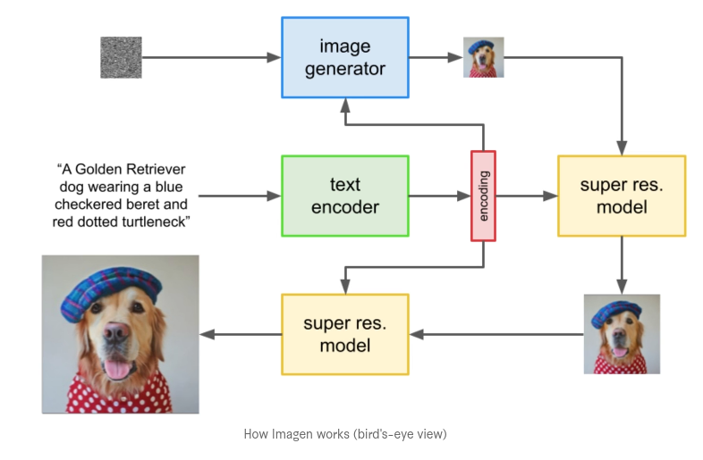
Text-to-image models (Dall-E2, Imagen)
Image credit: https://www.assemblyai.com/blog/how-imagen-actually-works/

Slide 27
CNNs in PyTorch

Slide 28
Convolutional layers
Input: tensor of size N × C_{i} × H_{i} × W_{i}
Hyperparameters:
C_{i} channels in
C_{o} channels out, i.e., the number of filters/different kernels
w, h: kernel size
padding: how to handle image borders
Output: tensor of size N × C_{o} × H_{o} × W_{o}
In PyTorch torch.nn.Conv2d(in_channels, out_channels, kernel_size, padding=’valid’) (there is also Conv1d and Conv3d)

Slide 29

Pooling layers
Used to reduce the spatial resolution
independently on each channel
reduce complexity and number of parameters
MAX operator most common
sometimes also AVERAGE
In PyTorch: torch.nn.MaxPool2d(pool_size) torch.nn.AvgPool2d(pool_size)
Image from http://cs231n.github.io/convolutional-networks/

Slide 30
Other layers
Flatten
flattens the input into a vector (typically before dense layers)
Dropout
similar as with dense layers
In PyTorch torch.nn.Flatten() torch.nn.Dropout(p)

